Slide 1
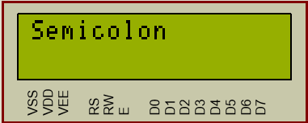
Liquid Crystal Device
By : Ahmad Hazem

Slide 2
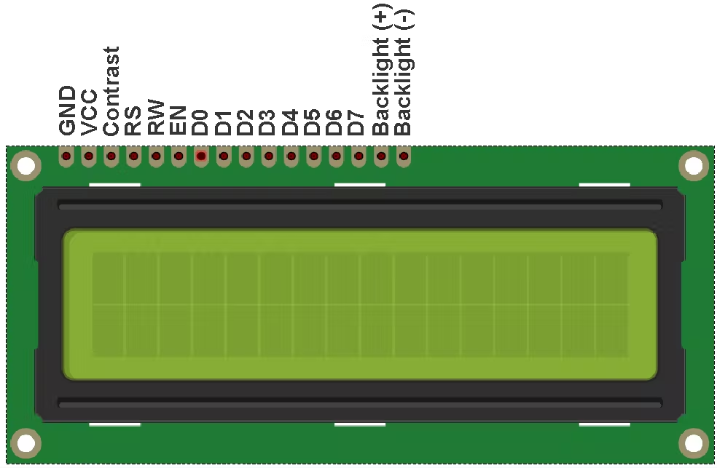
LCD 16x2 it consists of 16 column and 2 rows

Slide 3
LCD Pins (Power circuit )
Vss pin (GND): It is the ground pin for the LCD
VDD pin (VCC): It is the voltage entry pin for the LCD
VEE pin (contrast pin): It is the pin that control brightness of the LCD

Slide 4
LCD Pins (control circuit)
RS (Register Select pin)
It selects whether the LCD microcontroller will select the data register(1) or the command register(0)
RW (Read Write pin)
It selects whether the microcontroller will send data or receive data to the LCD. (By default it set to write (0) connected to the ground)
E (Enable pin)
It enables the LCD microcontroller when 1 and disables it when it 0

Slide 5
LCD Pins (data pins)
D0 – D7 (Data pins)
They are the pins where data or commands are sent by our microcontroller to the Liquid Crystal device microcontroller to either print the data or initiate specific functions.

Slide 6
DDRAM vs CGRAM
(DDRAM) Double Data random access memory:
It holds the character equivalent to the ascii code sent to be translated , and printer on the screen
It contains the functions initiated by the microcontroller on the screen
(CGRAM) Character Generator Random access memory:
It holds newly generated drawings, letters in it

Slide 7
4-bit mode vs 8-bit mode

Slide 8
High Pulse Signal
LCD_Port |= (1 << EN);
_delay_ms(1);
LCD_Port &= ~(1 << EN);
For the LCD to strobe the command or the data to its microcontroller, a high pulse signal is sent by the microcontroller as shown by the following code, the Enable pin is set to 1 then set to 0. The high pulse signal is sent to prevent strobing of noise signals to the microcontroller

Slide 9
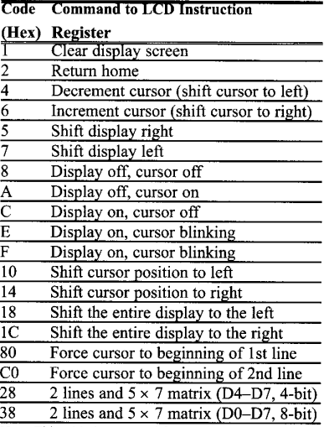
LCD commands

Slide 10
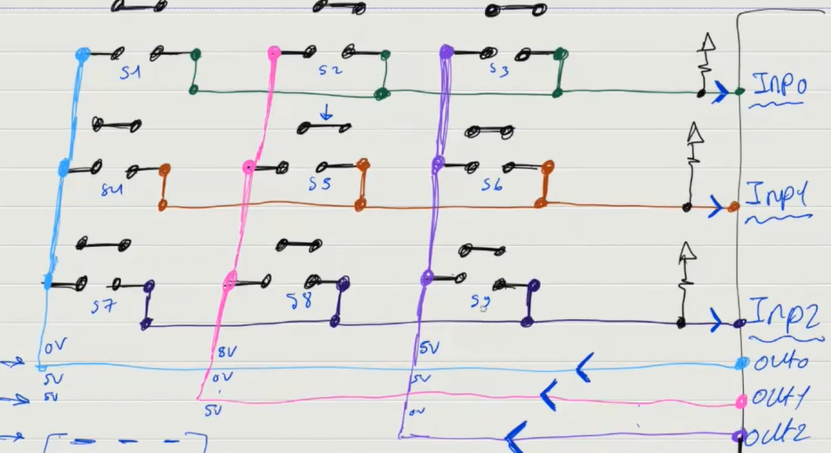
keypad

